Slide 1
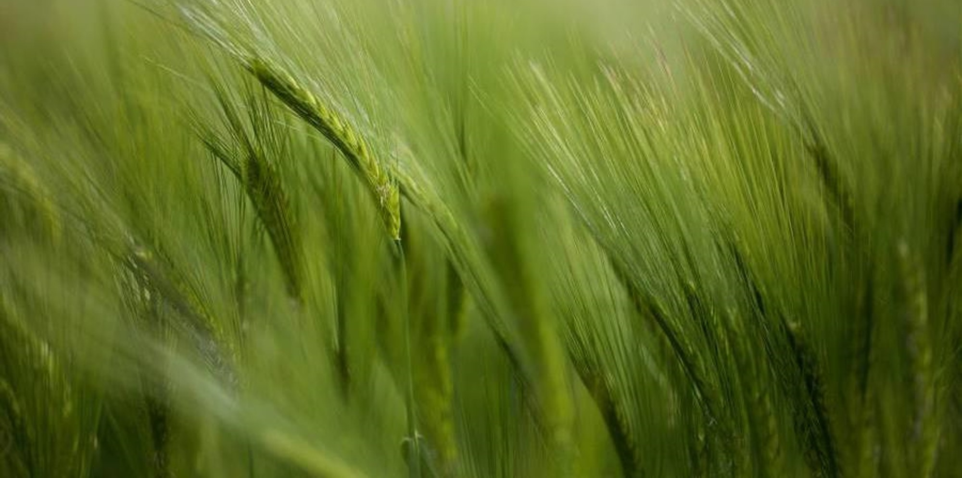


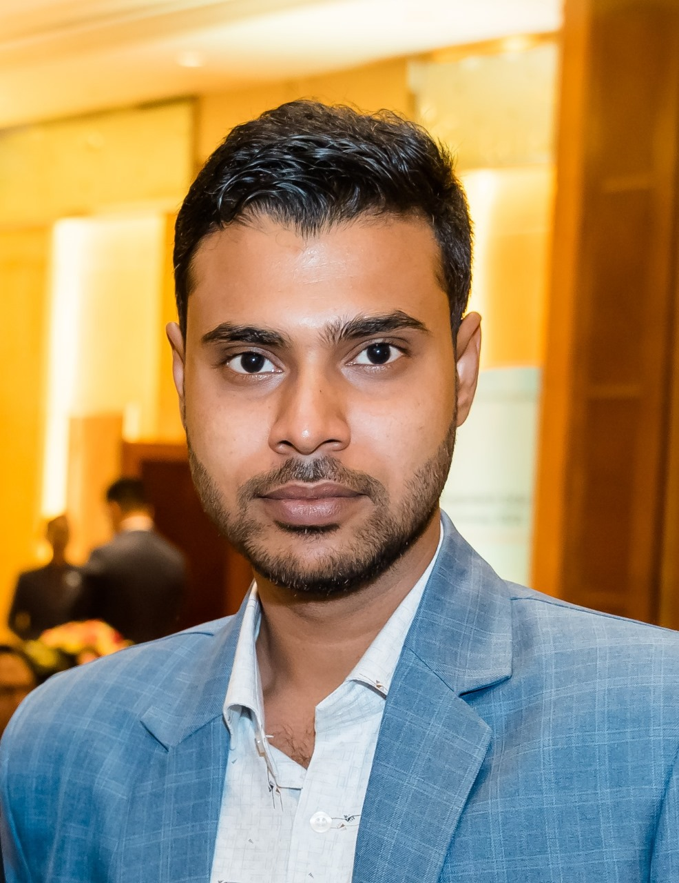



Md Mahfizur Rahman
University: OST - Eastern Switzerland University of Applied Sciences
Study program: MSE - Energy and Environment
Year of study: Graduate
Current City: Rapperswil, Switzerland
Motto: Learn, build, improve, and make a difference.
Hobbies: Technology projects, travelling, hiking and exploring sustainable-energy innovations..
Your expectations from the summer school:
To gain practical knowledge, exchange ideas, meet international participants, and learn new approaches for my future research and projects.
OST
Location: where I study, work and live.
Karlsruhe
31 August to 11 September 2026

